Slide 1
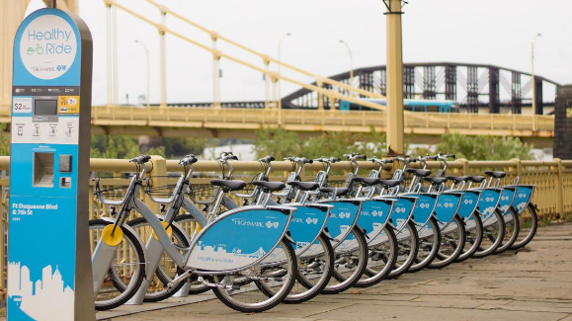
Pittsburgh Healthy Ride Analysis

Slide 2
Brief History
The Healthy Ride program is operated by Pittsburgh Bike Share
The program is a 501©3 non-profit
Service began December 2012;
Raised capital of about $1.6M in 2013
Rideshare system piloted in 2015 reaching up to 50 stations across the Pittsburgh area
Their mission is to provide “joyful, sustainable, and affordable mobility service to residence and visitors
Cost is based on User Type: Customers (pay as you go) pay $2 /30 min; Subscribers pay either $12 per mo./unlimited 30 min ride or $20 per mo./unlimited 60 min ride

Slide 3
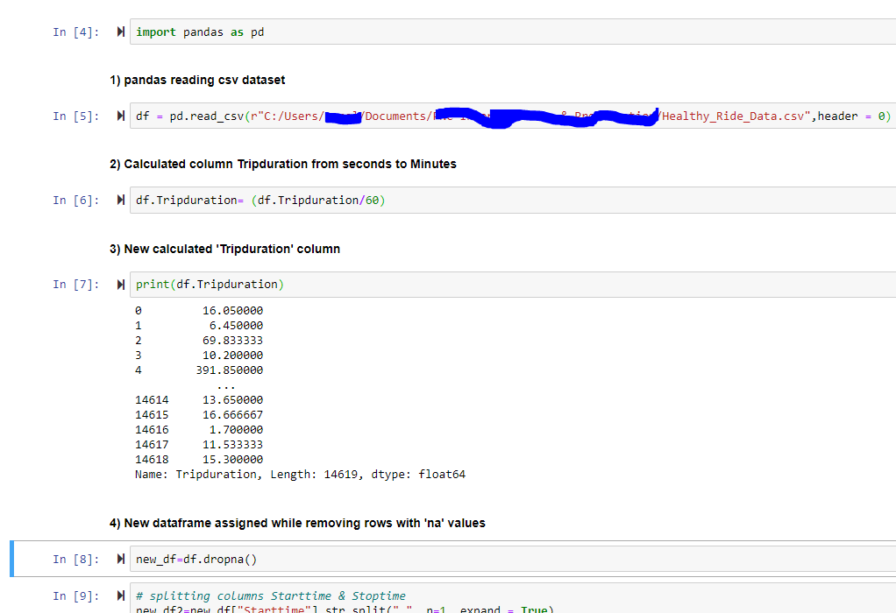
Brief History
Python script to read csv dataset and begin cleaning process of data

Slide 4
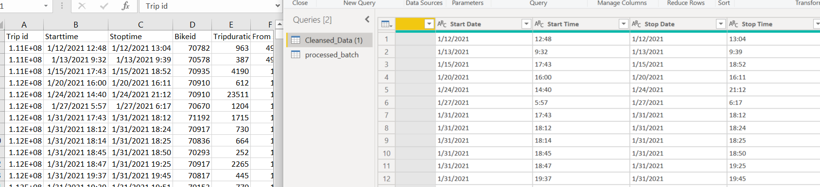
Brief History
Used Power Query and DAX for parsing cleansed data set columns:
Left is original csv dataset with columns B and C as date/time.
Right is cleansed data set with columns B and C parsed into individual date and time columns and data type for easier aggregation

Slide 5
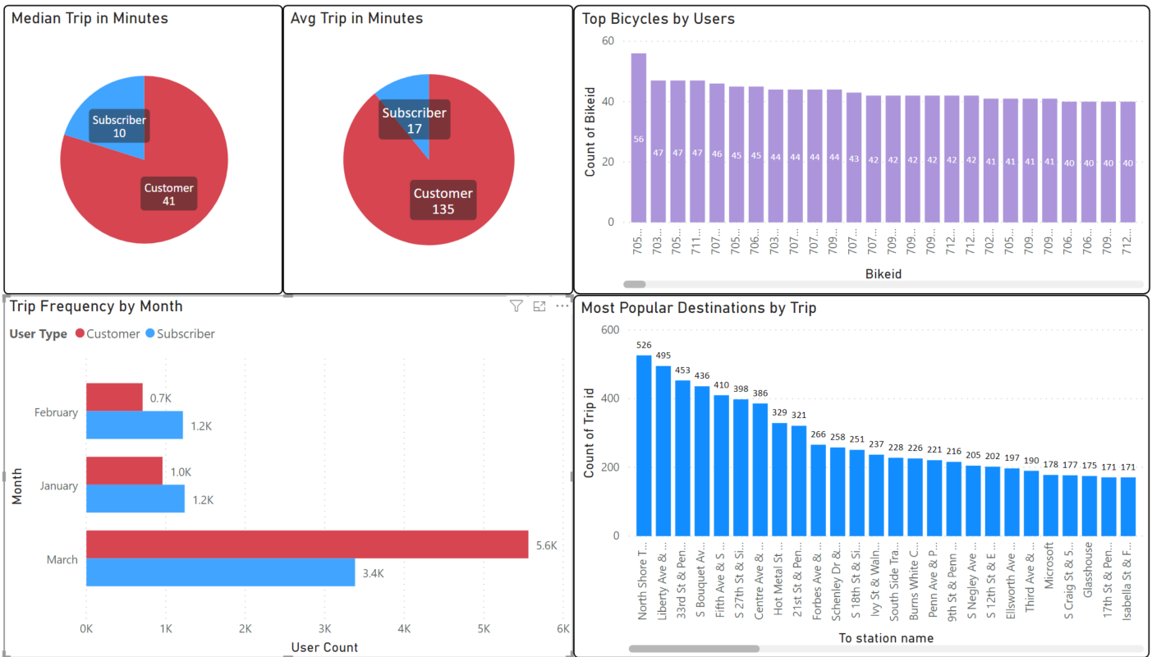
The analysis
Power BI Visualization:
Median Trip Duration in minutes
Avg Trip Duration in minutes
Trip Frequency by Month
Top Bicycles by Users
Most Popular Destination by Trip

Slide 6
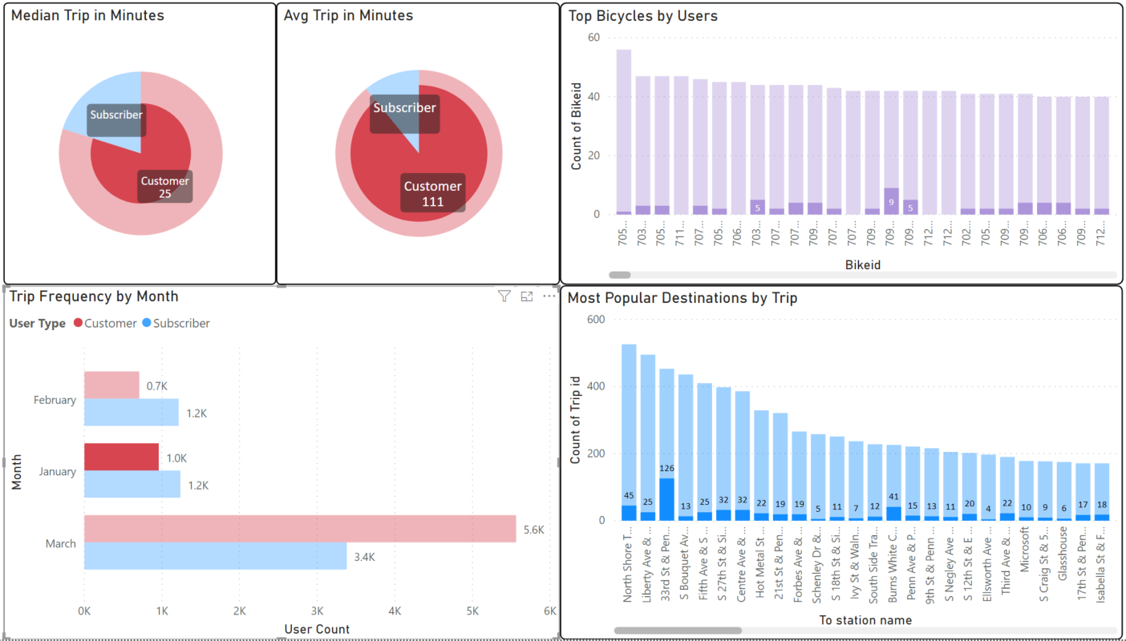
The analysis
Power BI Visualization:
Median Trip Duration in minutes
Avg Trip Duration in minutes
Trip Frequency by Month
Top Bicycles by Users
Most Popular Destination by Trip

Slide 7
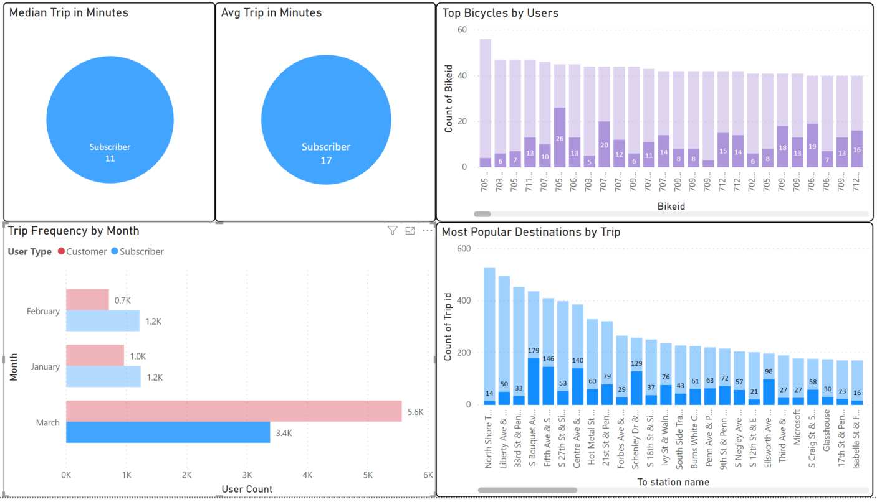
The analysis
Power BI Visualization:
Median Trip Duration in minutes
Avg Trip Duration in minutes
Trip Frequency by Month
Top Bicycles by Users
Most Popular Destination by Trip

Slide 8
So why is this important?

Slide 9
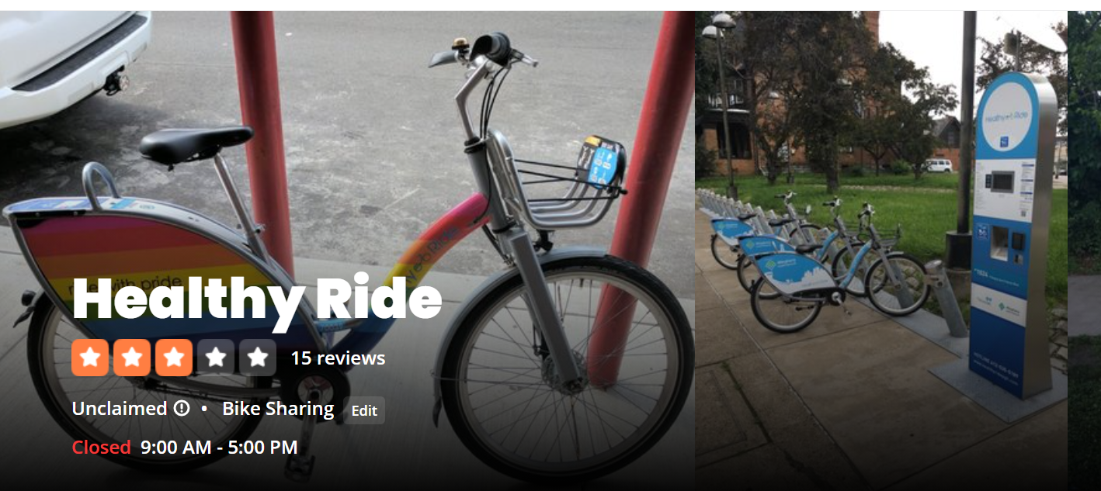
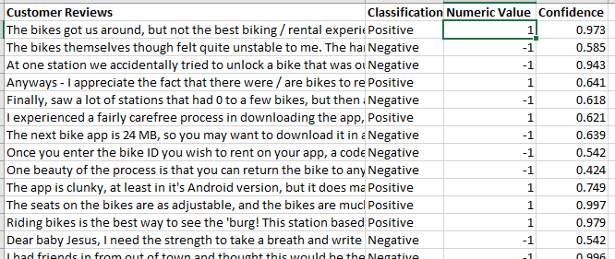
Sentiment analysis
Sentiment Analysis:
Customer Reviews
Classification
Numeric Value assigned to classification
Confidence of sentiment analysis model to review string

Slide 10
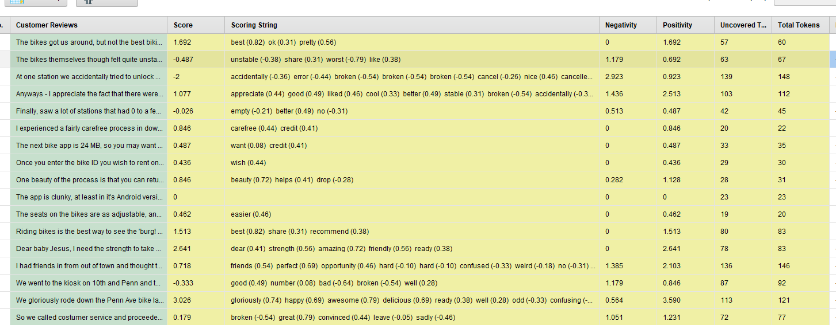
The analysis
Screenshot of sentiment analysis in rapid miner:
Shows how sentences are separated into individual strings and assigned numeric values. Strings are then tokenized

Slide 11
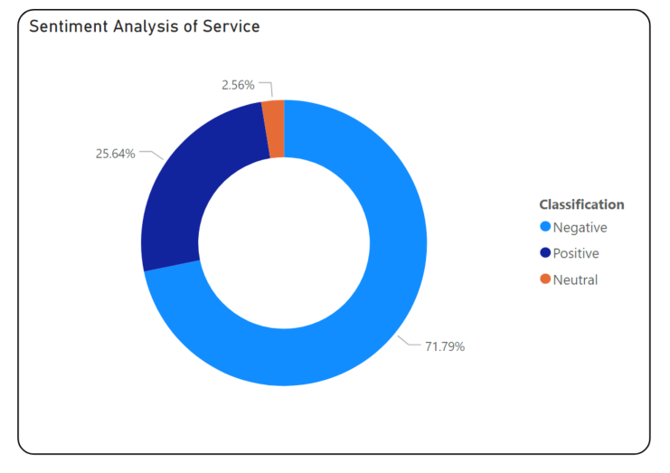
The analysis
Sentiment Analysis Donut Graph:
2.56% Customers Have Neutral Sentiment
25.64% Customers have Positive Sentiment
71.79% Customers have Negative Sentiment

Slide 12
Conclusion
Healthy Ride is a healthier option for all who partake
Likely increases tourist revenue to the city since patrons can perform more self-guided tours
Great alternative public transportation and walking especially since the onset of Covid-19
Project would likely see improved customer reviews by fixing technical issues and provide more training to phone staff since most customer sentiments pertained to technical issues of application and dealing with customer service agents

Slide 13
Approach to analysis

Slide 14
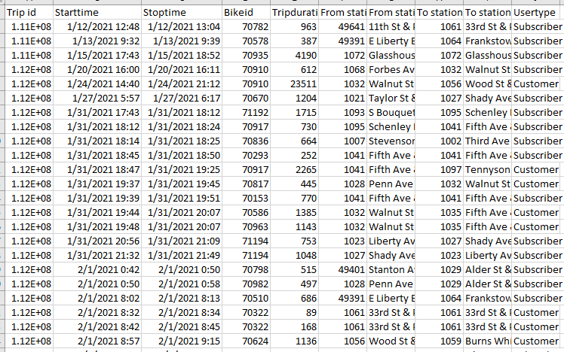
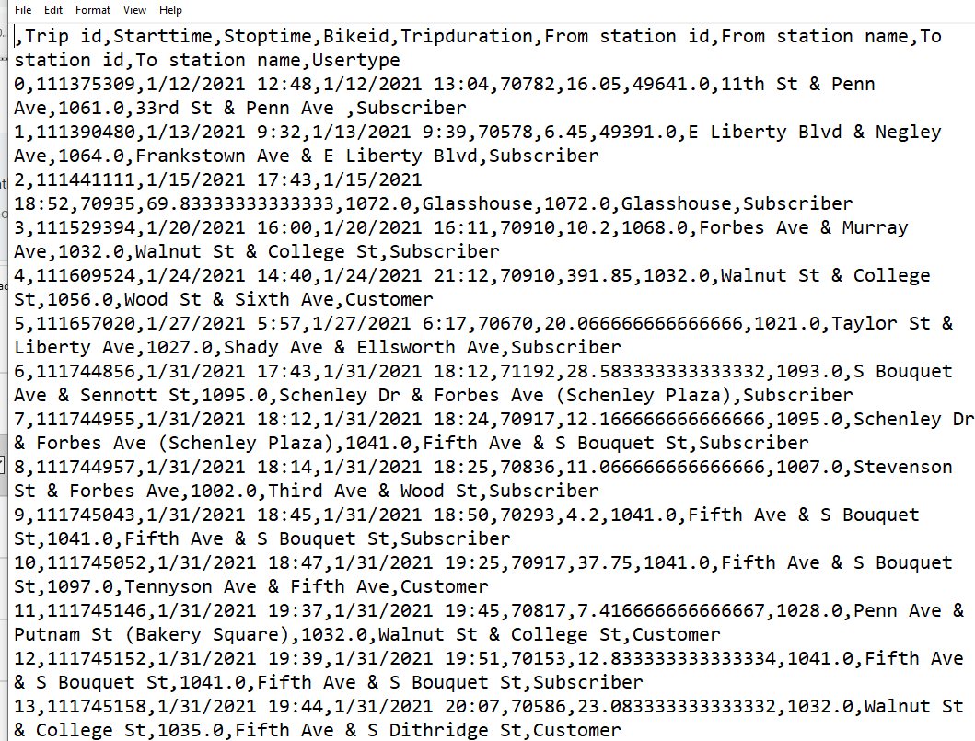
Cleansed data

Slide 15
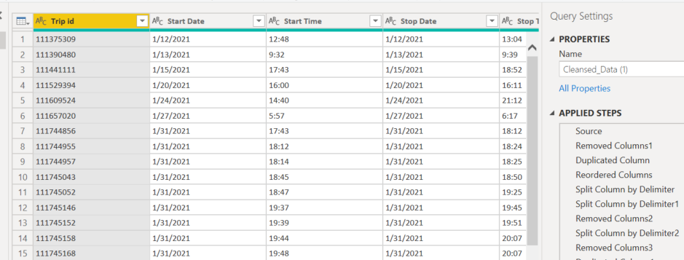
Transformed & Loaded Data

Slide 16
Questions?

